Slide 1

EC601-A1-04
American Express
-Default Prediction
licao@bu.edu
hyc1011@bu.edu
zcz@bu.edu
aubryma@bu.edu
Github Link: https://github.com/licao2998/EC601-A1-04

Slide 2
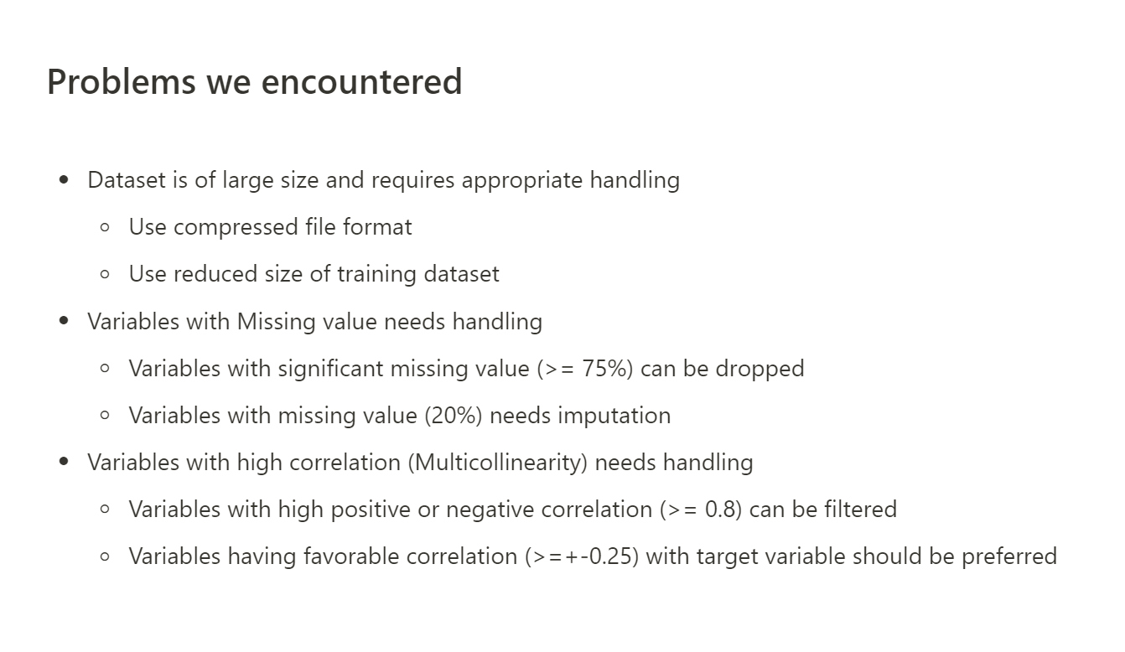
Notes:
Review the problems we encountered
Due to the large file size of the original dataset (around 50 GB), it is not advisable to read and analyze the data directly.
So as for the things we did
1. We appled Data Compression
Compression of the data values can be considered before feeding into the model, and specific compression methods include
Replacing the category field in the dataset with category from Pandas.
Taking the numeric fields in the dataset and using flaoat16 and float32 instead of the original float64.
storing the dataset using feather or parquet format.
We did more literature review. Deeper, not general. We referred to Others who did the Kaggle project and has a public notebook and found out their approaches to select the correlated data

Slide 3
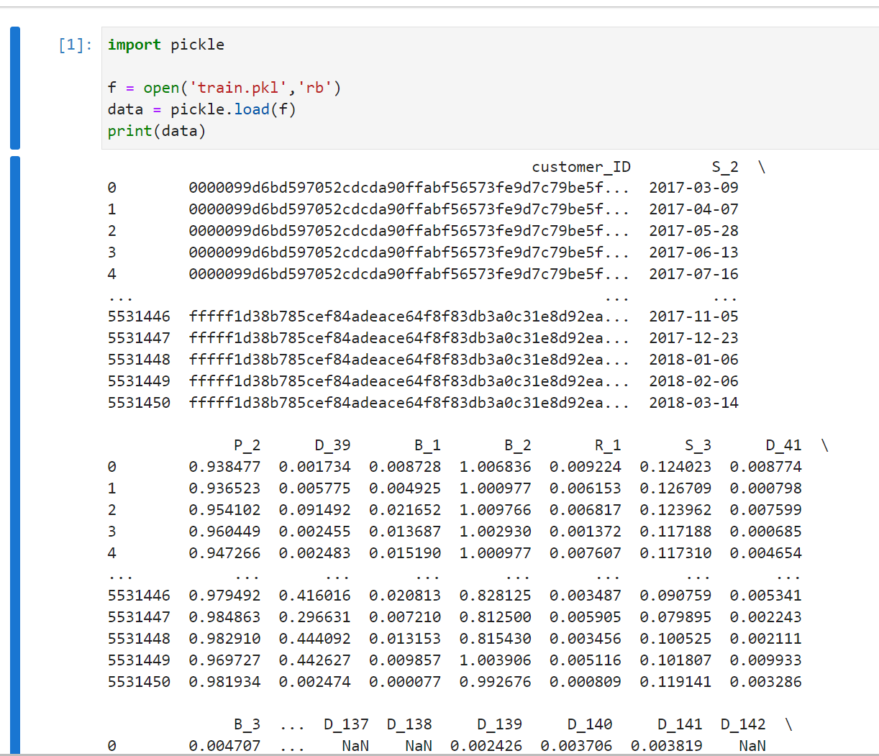
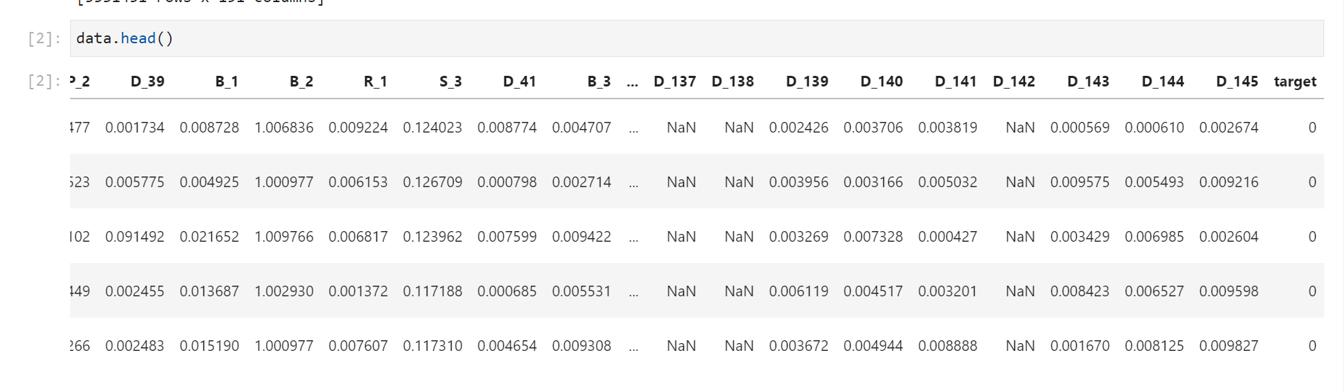
1
D_* = Delinquency variables
S_* = Spend variables
P_* = Payment variables
B_* = Balance variables
R_* = Risk variables
[5531451 rows x 191 columns]
Notes:
What does data look like for train_data.csv?
Simple observations
There are total 190 variables in train_data.csv dataset
There are 185 variables(Columns) as dtype float64, 1 variable(Column) as dtype int64 and 4 variables(Columns) as dtype object
customer_ID has encrypted value
S_2 variable has date as value
S_3 and few D variables appears to have missing value

Slide 4
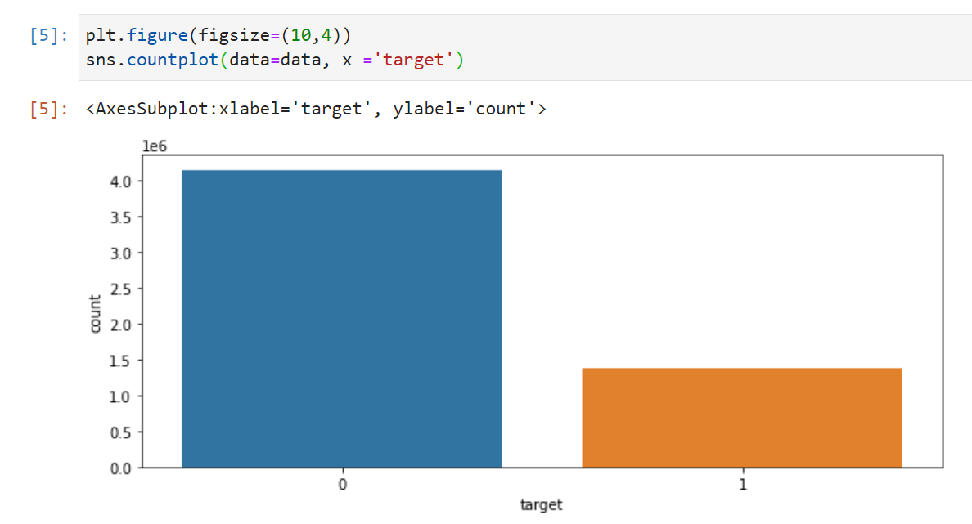
1
Data Visualization
D_* = Delinquency variables
S_* = Spend variables
P_* = Payment variables
B_* = Balance variables
R_* = Risk variables
[5531451 rows x 191 columns]
Notes:
First is the distribution of target label
target variable has 74.1% as target=0(Not Default) and 25.9% as target=1(Default)

Slide 5
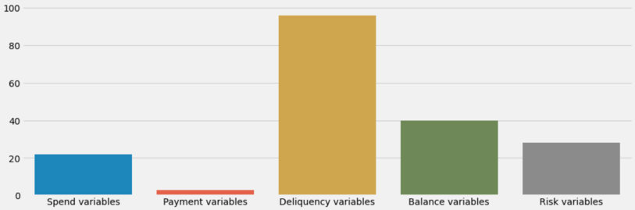
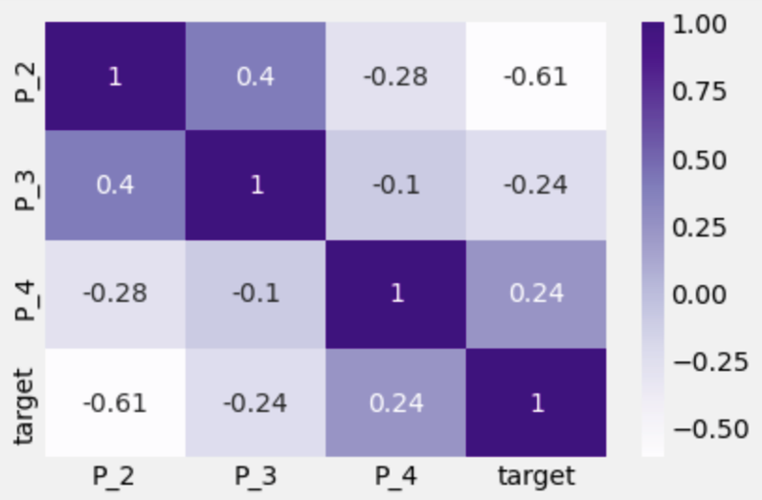
1
D_* = Delinquency variables
S_* = Spend variables
P_* = Payment variables
B_* = Balance variables
R_* = Risk variables
[5531451 rows x 191 columns]
Notes:
Each column of the dataset has csutomer_ID, date, various features, and we want to derive the probability of future repayment for each customer_ID based on these. The features are really large and desensitized (Data masking), and it is not quite possible to combine features by realistic ideas. Feature Engineering is the process of transforming raw data into features that better express the nature of the problem, allowing the application of these features to predictive models to improve the accuracy of model predictions on invisible data.
Feature engineering is simply the discovery of features that have a significant effect on the dependent variable y, usually referred to as the independent variable x. The purpose of feature engineering is to discover important features. feature engineering is manually designing what the input x's should be. you have to turn your inputs into things the algorithm can understand. How can you decompose and aggregate raw data to better represent the nature of the problem? This is the purpose of doing feature engineering. Feature engineering is the most time consuming and important step in data mining model development.

Slide 6
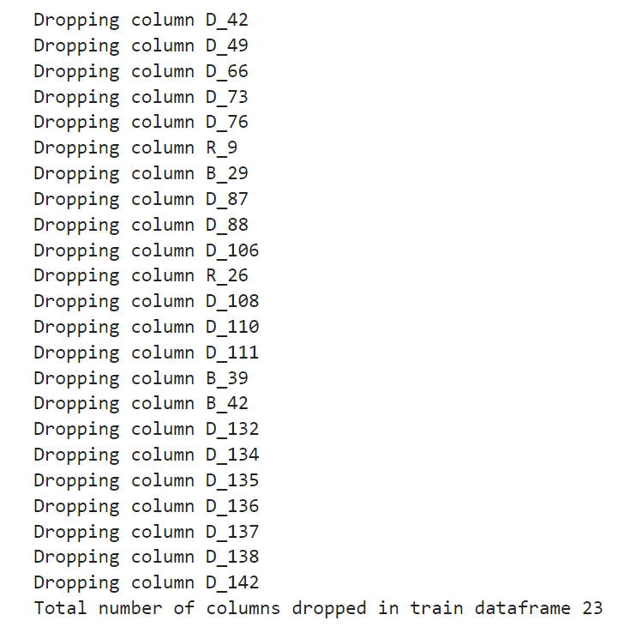
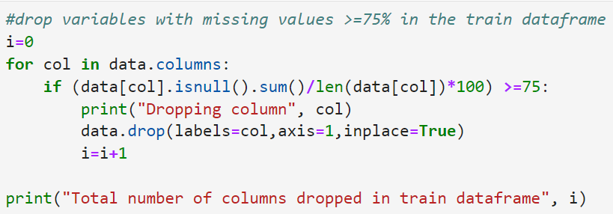
Handle Variable with Missing value
Notes:
First is the distribution of target label
target variable has 74.1% as target=0(Not Default) and 25.9% as target=1(Default)
And

Slide 7
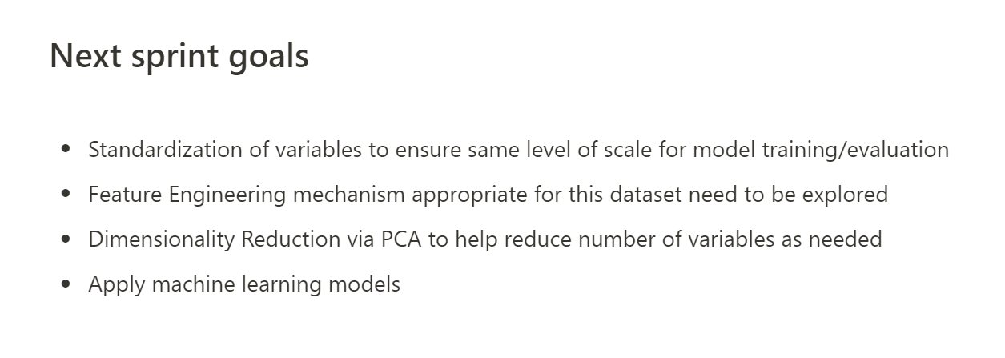

Slide 8
Thanks for listening

